Slide 1
Assalamu Alaikum my dear students
Welcome everybody

Slide 2
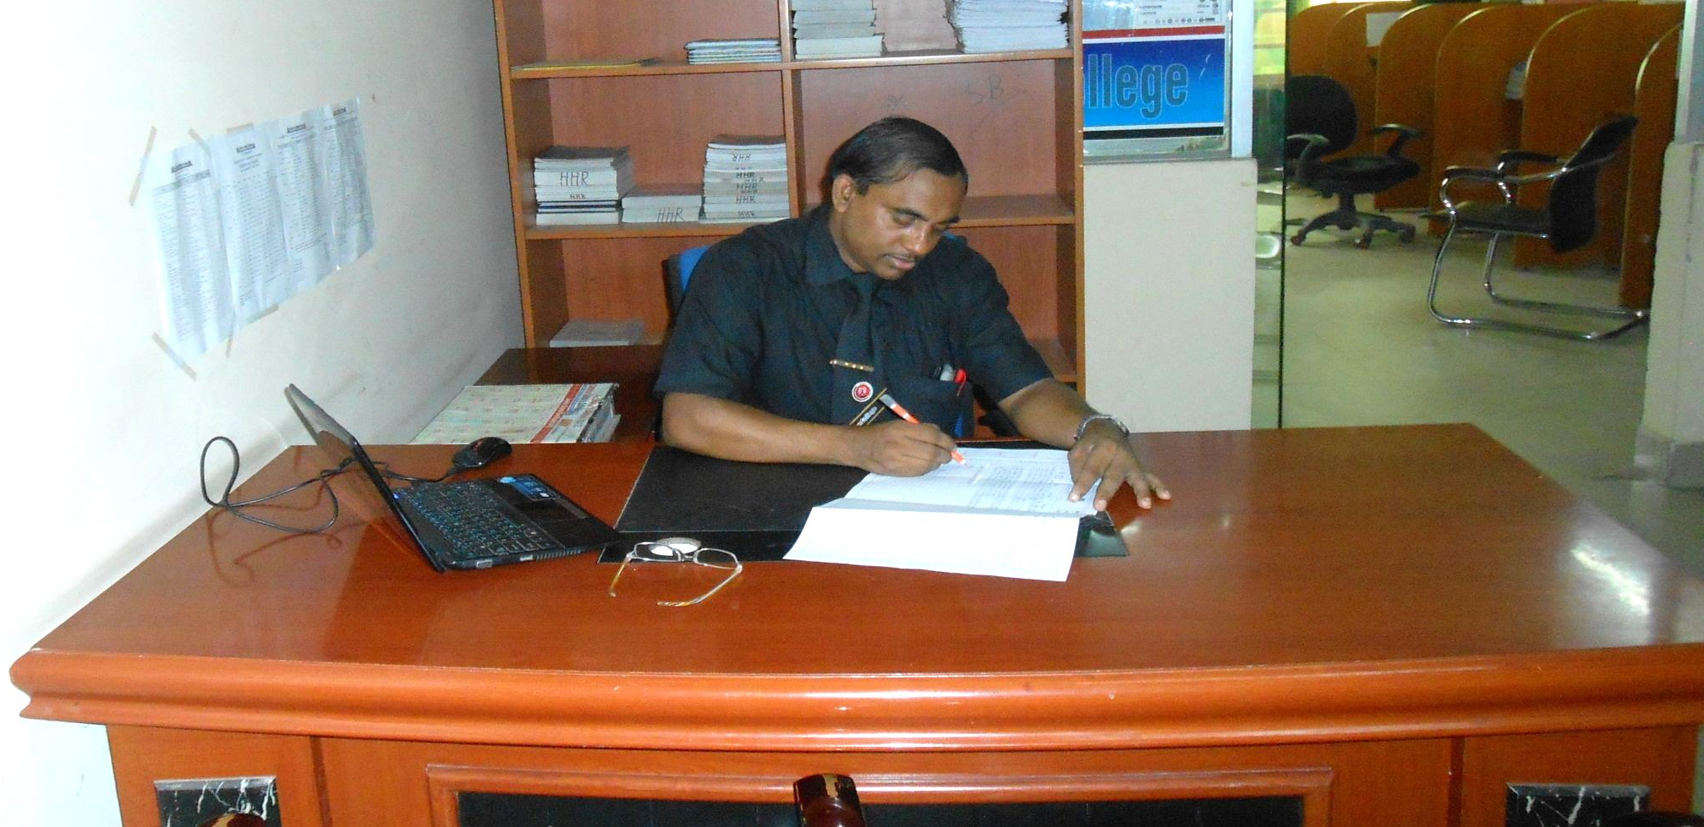
Md Hasan Hafizur Rahman
Senior Lecturer
Department of English
Cambrian School College
Dhaka
Class-VIII
English First Paper
Writing Part

Slide 3
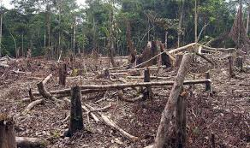
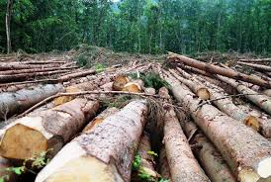
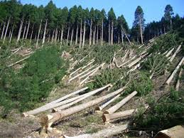
What does it mean?
Deforestation

Slide 4
Our Today’s Lesson is-
A Dialogue on
“Deforestation”

Slide 5
Learning outcomes
After we have studied this lesson we will be able to-
know information
ask and answer questions
have the idea of deforestation
write a dialogue.

Slide 6
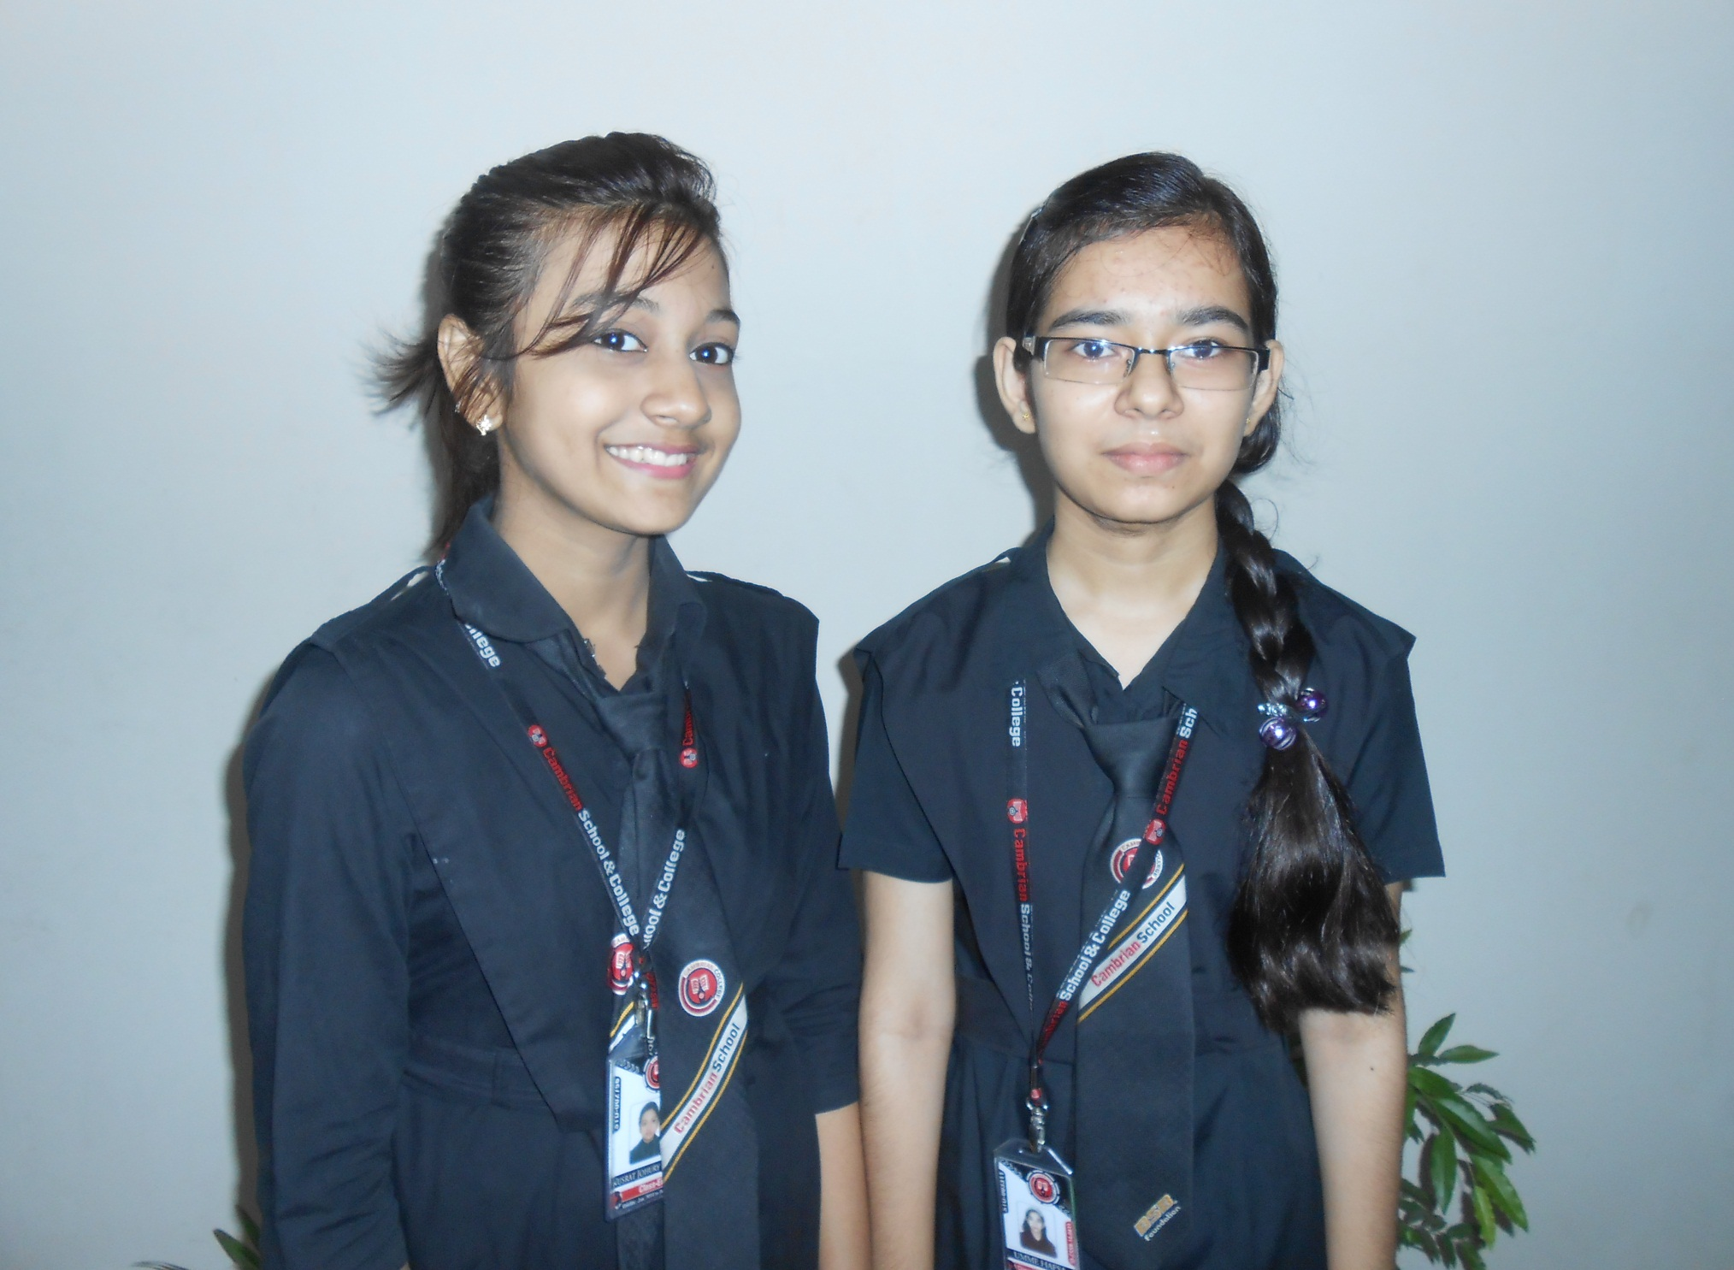
Pranti
Eishi

Slide 7
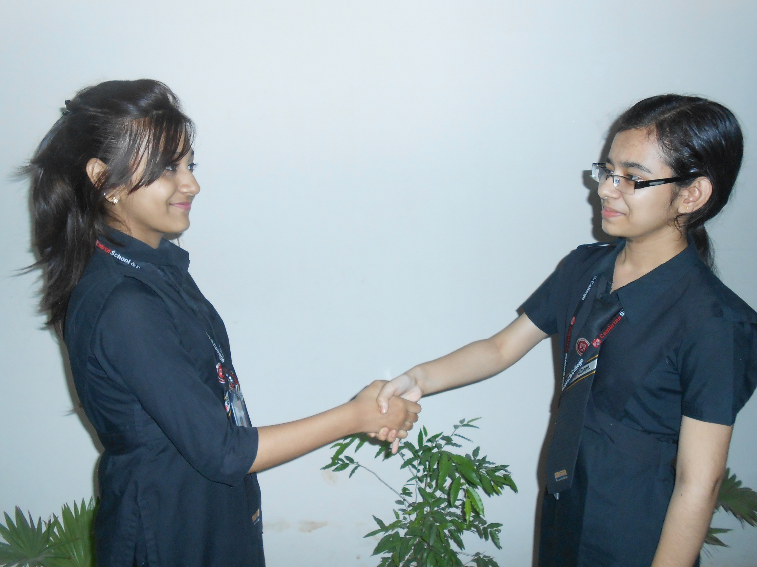
Assalamu Alaikum.
Walaikum Assalam.

Slide 8
How are you my friend?
Alhamddulillah. What about you?

Slide 9
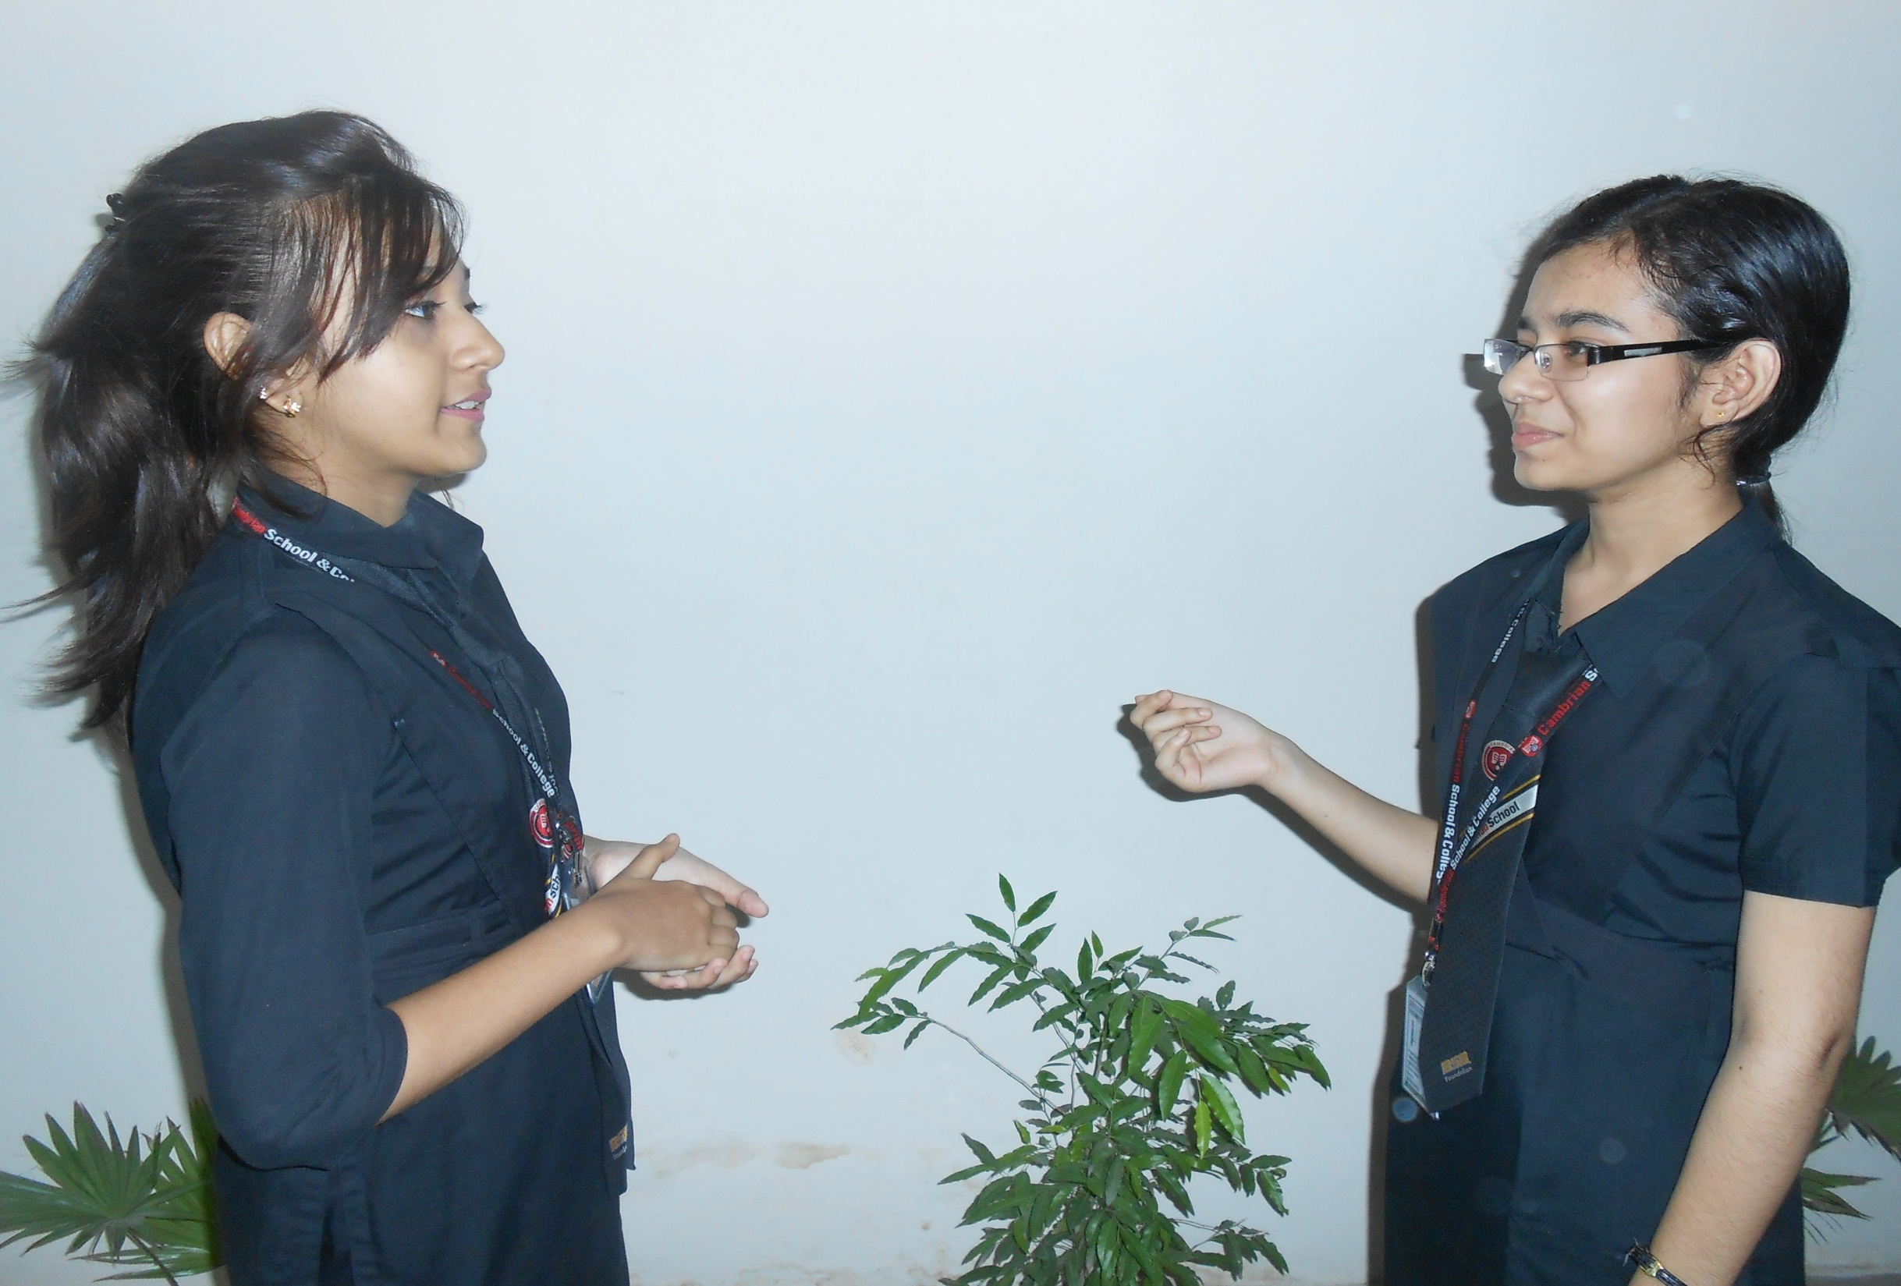
By Allah’s grace I am well.
Dear friend, I have something to ask you.

Slide 10
Oh, sure! Why not?
Would you tell me about deforestation?

Slide 11
Deforestation means cutting trees at random.
Is it beneficial for us?

Slide 12
Oh, ‘No’ It is never be beneficial for us.
What is the negative impact of deforestation?

Slide 13
There is no positive impact of deforestation. All are negative.
Would you explain some of them?

Slide 14
It is the first threat to our environment.
What do you mean?

Slide 15
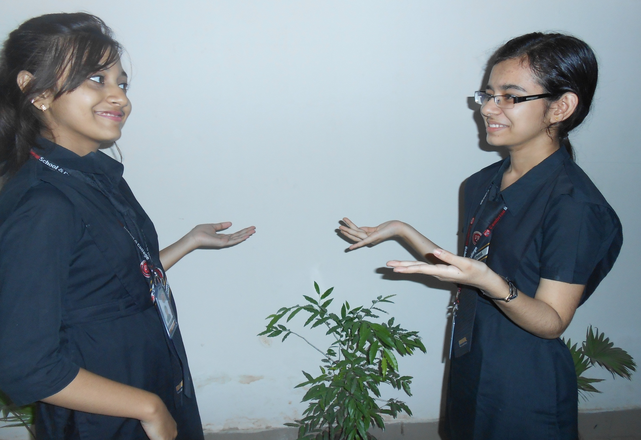
I mean deforestation will totally ruin our ecological balance.
Can it cause any bad effect on our weather?

Slide 16
Of course. Don’t you follow the weather so hot?
Yes, I am anxious of the weather.

Slide 17
Not only weather but it also causes green house effect.
Really?

Slide 18
Yes, this is the reality.
What is our duty now?

Slide 19
It is very clear that we have to stop deforestation right now.
But I think more than this.

Slide 20
What do you think?
I think we all should plant more trees to save our environment.

Slide 21
How excellent your idea is! It is exactly awesome.
As you think.

Slide 22
Thank you for sharing your valuable idea about deforestation.
Thank you also.

Slide 23
Group Work
Grop Work

Slide 24
Evaluation
Answer the following questions-
What is deforestation?
What is the negative impact of deforestation?
What does it cause to our environment?
Why should we do to stop deforestation?

Slide 25
Homework
Write a dialogue on
“Deforestation”

Slide 26
Verse Universal
“No living being can live without tree.”

Slide 27
Allah Hafez

